Slide 1
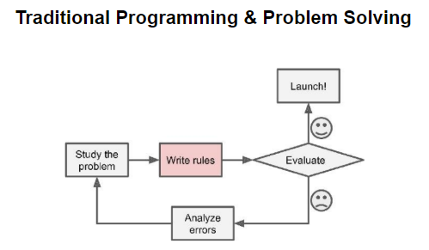
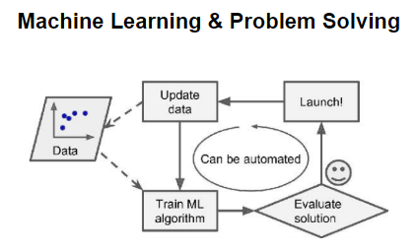

Slide 2
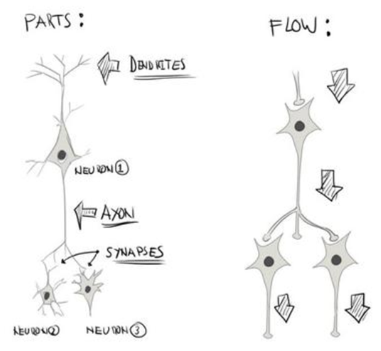
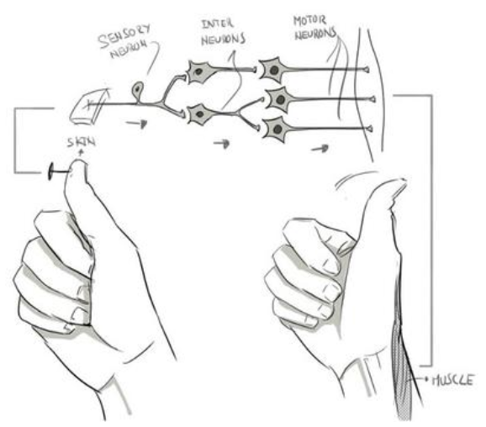

Slide 3
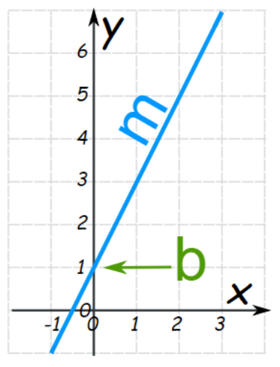
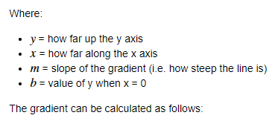
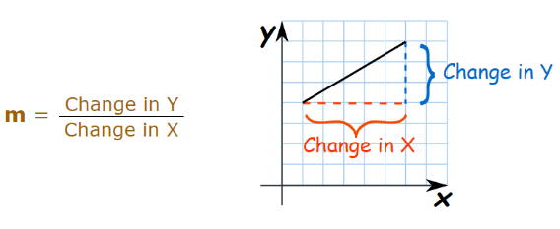

Slide 4
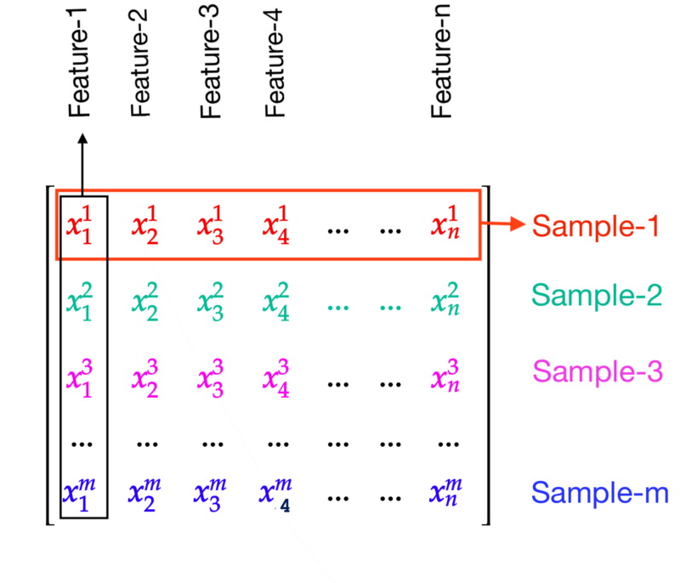
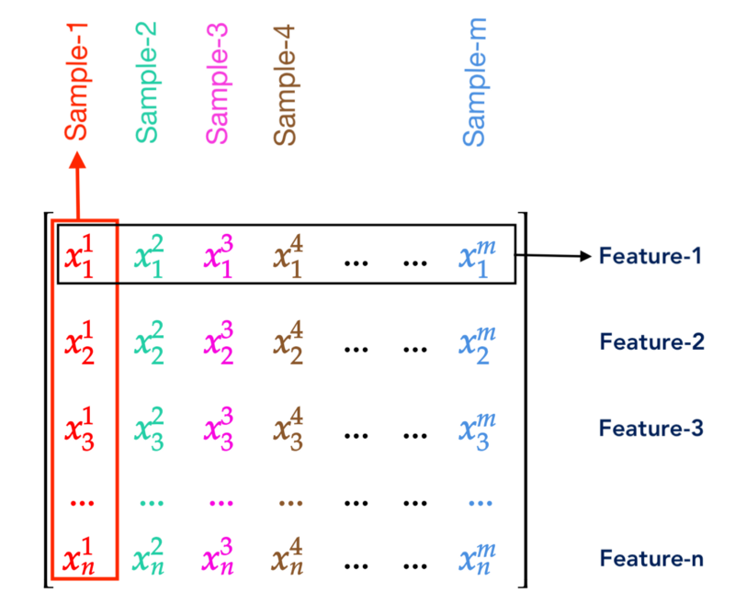
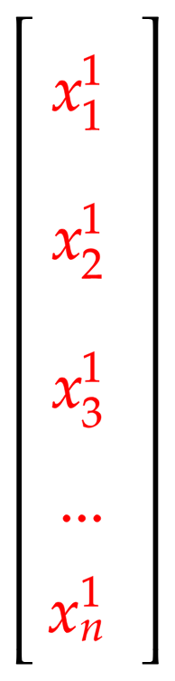
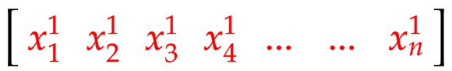
Features Notation
Features as Columns
Features as Rows
x
Sample number
^{i}
_{j}
Feature number
x
Sample 1
x
Sample 1
¹
¹
₂
Feature 1

Slide 5
n
m
X
= number of features
= number of samples
= all samples, i.e. matrix of m x (n + 1) dimensions (for the below example)
x
Sample 1
x
Sample number
¹
y
^{i}
_{j}
x
= all y values, i.e. vector of m x 1 dimensions (for the below example)
Feature number
¹
Sample 1
₂
Feature 1
n + 1
n = 4
 | x₀ | x₁ | x₂ | x₃ | x₄ | y
 | Bias Unit | Size (feet²) | No. of rooms | No. of floors | Age of Home | Price ($1000)
x¹ | 1 | 2104 | 5 | 1 | 45 | 460
x² | 1 | 1416 | 3 | 2 | 40 | 232
x³ | 1 | 1534 | 3 | 2 | 30 | 315
x⁴ | 1 | 852 | 2 | 1 | 36 | 178
x⁵ | … | … | … | … | … | …
x^{m} | m | m | m | m | m | m
x¹ = sample 1
m
y = y values
x
= sample 3, feature 2
³
₂
x₁ = feature 1

Slide 6
n
m
X
= number of features
= number of samples
= all samples, i.e. matrix of m x (n + 1) dimensions (for the below example)
x
Sample 1
x
Sample number
¹
y
^{i}
_{j}
x
= all y values, i.e. vector of m x 1 dimensions (for the below example)
Feature number
¹
Sample 1
₂
Feature 1
n + 1
n = 1
 | x₀ | x₁ | y
 | Bias Unit | Size (feet²) | Price ($1000)
x¹ | 1 | 2104 | 460
x² | 1 | 1416 | 232
x³ | 1 | 1534 | 315
x⁴ | 1 | 852 | 178
x¹ = sample 1
m = 4
y = y values
x
= sample 3, feature 2
³
₂
x₁ = feature 1

Slide 7
n
m
X
= number of features
= number of samples
= all samples, i.e. matrix of m x (n + 1) dimensions (for the below example)
x
Sample 1
x
Sample number
¹
y
^{i}
_{j}
x
= all y values, i.e. vector of m x 1 dimensions (for the below example)
Feature number
¹
Sample 1
₂
Feature 1
n + 1
n = 2
 | x₀ | x₁ | x₂ | y
 | Bias Unit | Size (feet²) | No. of Rooms | Price ($1000)
x¹ | 1 | 2104 | 5 | 460
x² | 1 | 1416 | 3 | 232
x³ | 1 | 1534 | 3 | 315
x⁴ | 1 | 852 | 2 | 178
x¹ = sample 1
m = 4
y = y values
x
= sample 3, feature 2
³
₂
x₁ = feature 1

Slide 8
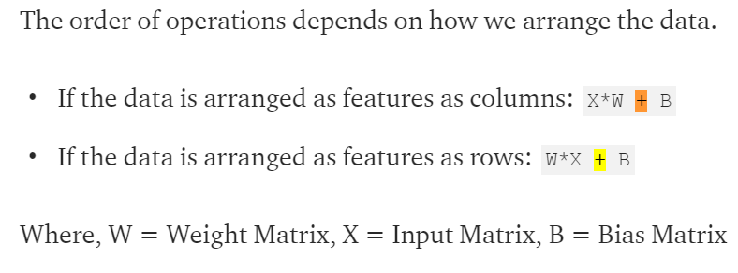
Features Notation
Order of Operations
x
Sample number
^{i}
_{j}
Feature number
x
Sample 1
¹
₂
Feature 1
Features as Columns
Features as Rows
x
Sample 1
¹

Slide 9

Neural Network Mathematical Notation
Layer 1
Input Layer
Layer 2
Hidden Layer
Layer 1
Input Layer
Layer 2
Hidden Layer
Layer 3
Output Layer
Departure Airport
Ɵ
^{l}
Departure layer I am moving from
X₀
a₁
X₀
_{i}
_{j}
⁽²⁾
Departure Gate
Ɵ
¹
Departure node I am moving from
₁₀
Destination node I am moving to
Arrival Gate
X₁
a₂
h_{Ɵ}(x)
⁽²⁾
Ɵ
¹
X₁
₁₁
a₁
⁽²⁾
X₂
a₃
⁽²⁾
Means:
1 = mapping from layer 1
2 = mapping from node 2 in layer 1
1 = mapping to node 1 in layer 1 + 1
Ɵ
¹
X₂
₁₂

